Slide 1
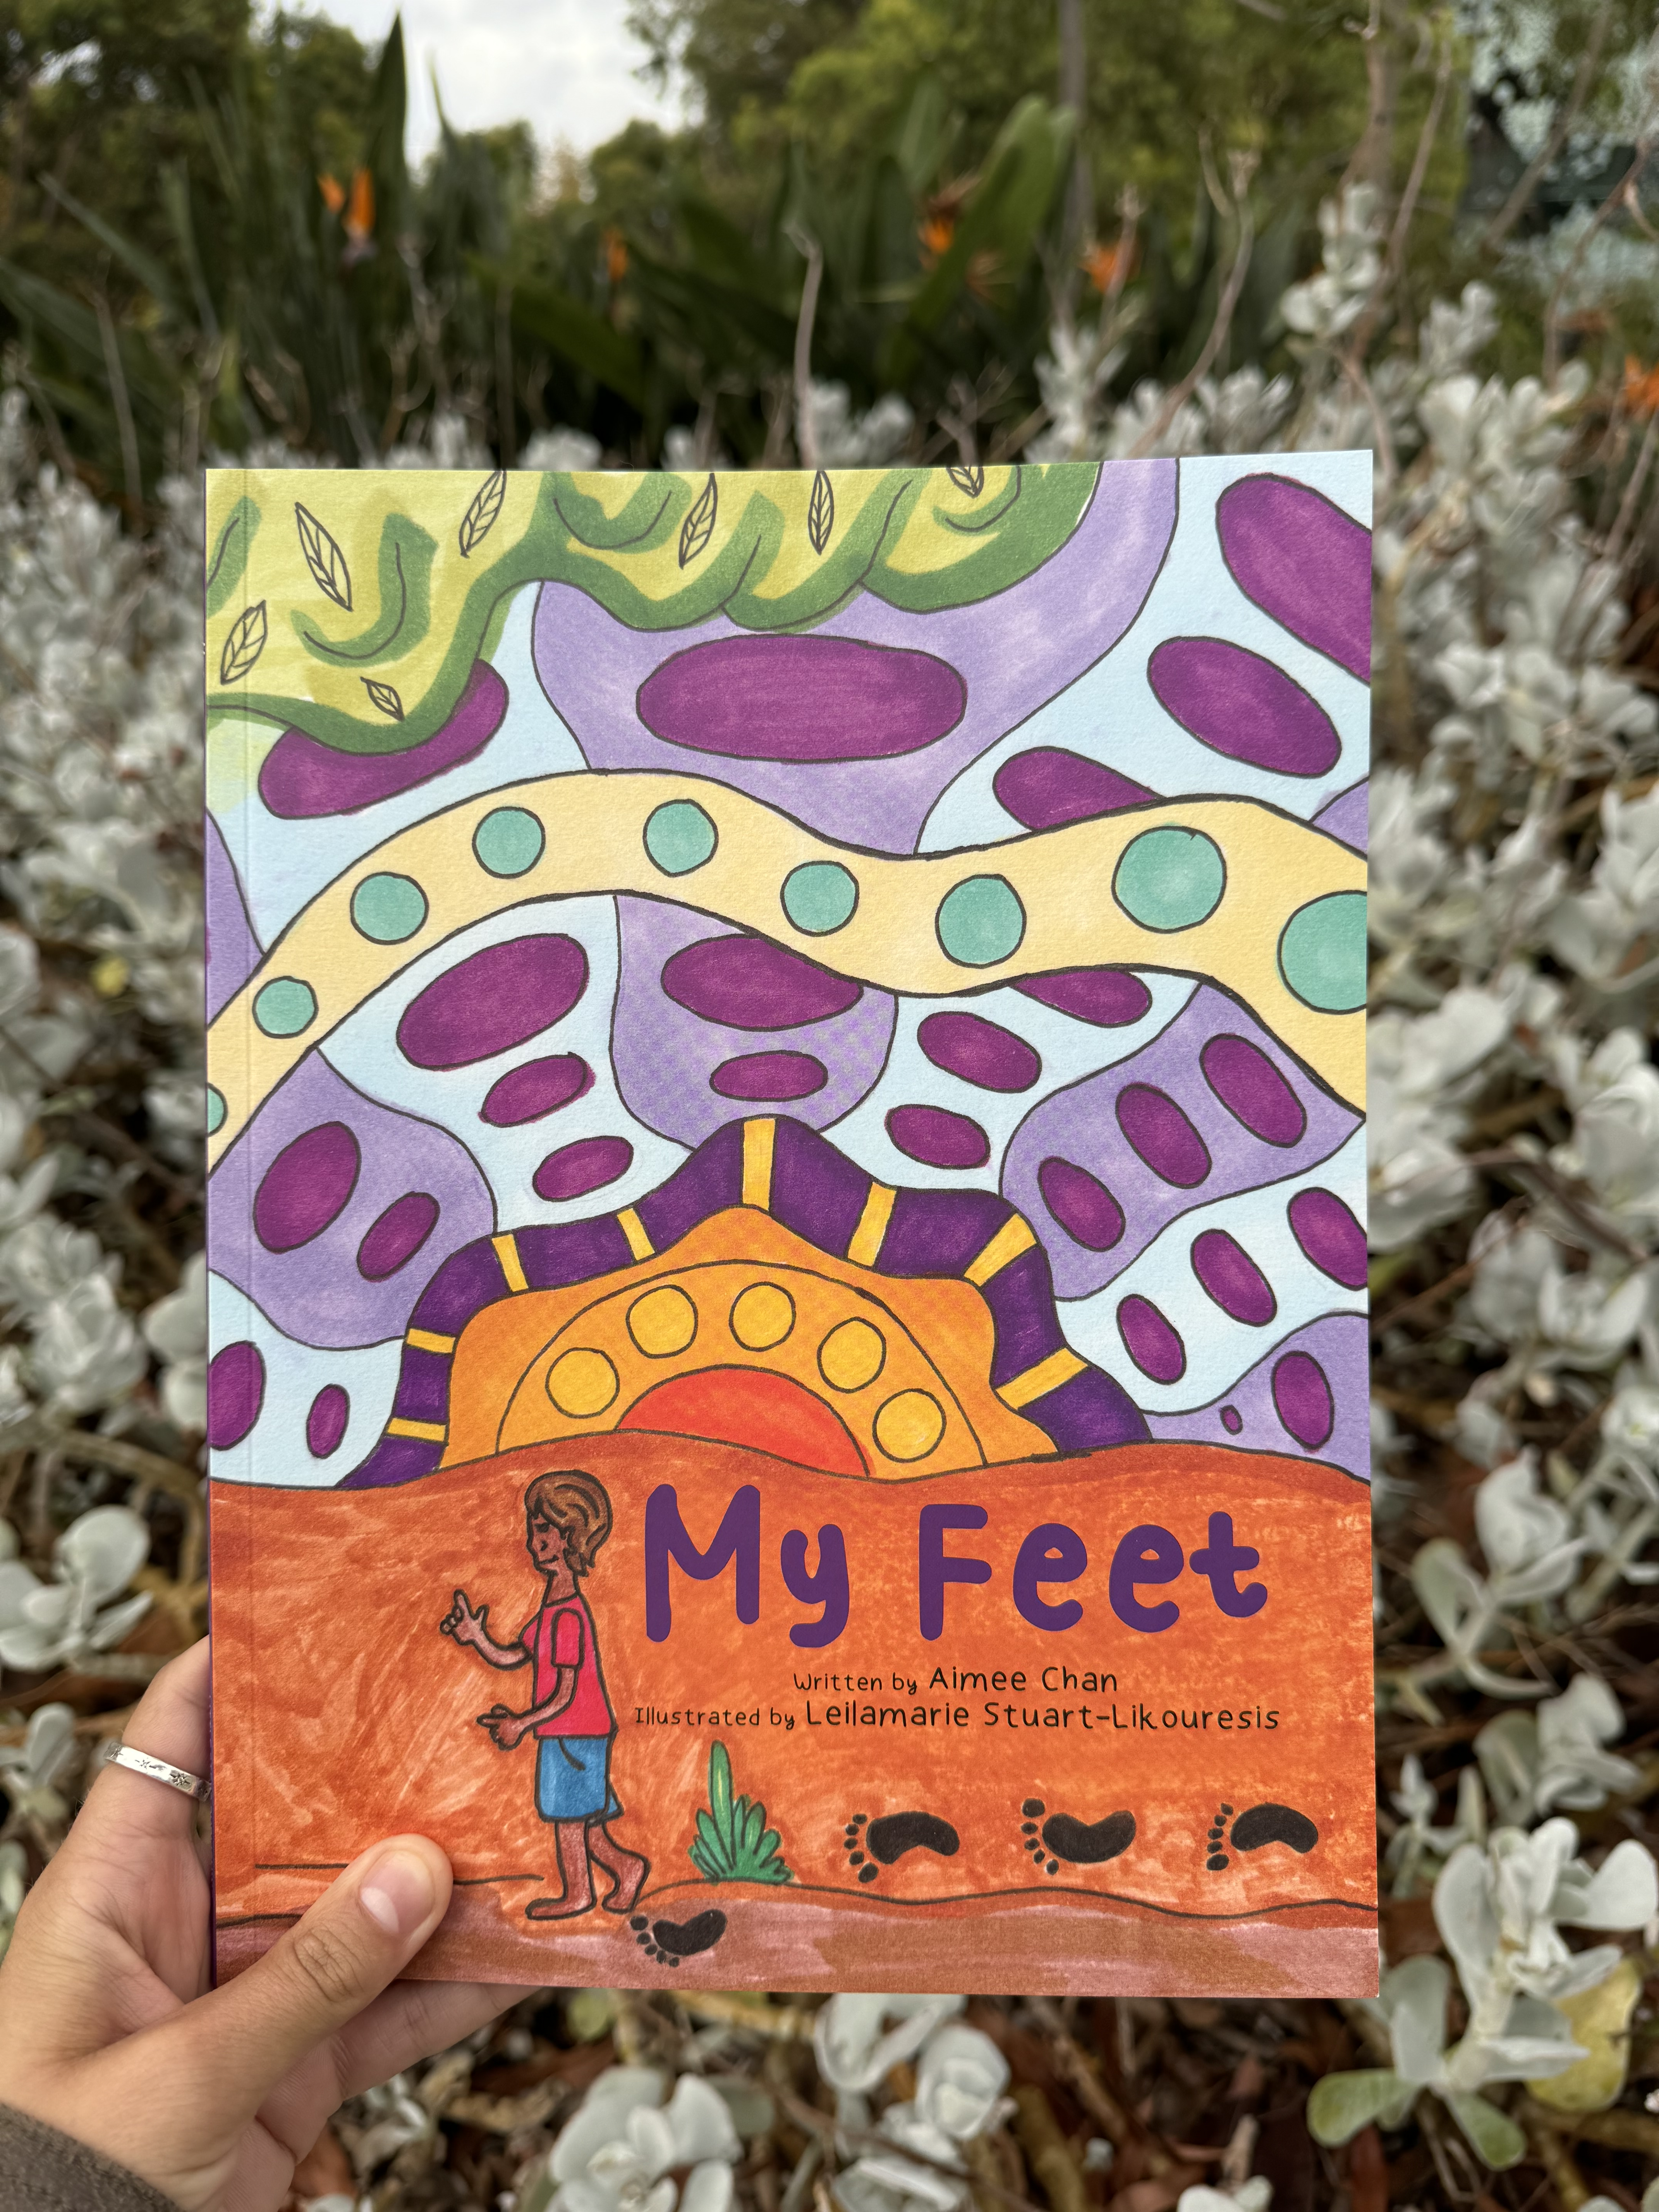
My Feet Curriculum Resource: Foundation
Resource developed by Ngarrpadlarna Mila & Walk Strong, Walk Tall
[CC BY-NC-ND license]
Written by Aimee Chan
Illustrated by Leilamarie Stuart-Likouresis
Notes:
Content will need to be enabled for Youtube videos to play. Similarly, they can be opened via Youtube in the internet browser as all links are provided.

Slide 2
Thank you for utilising this resource
We recognise First Nations peoples’ cultural, spiritual, physical and emotional connection with their land. We honour and pay our respects to First Nations Elders, both past and present. We recognise the cultural knowledge of Ngarrpadlarna Mila and thank them for their collaboration on this piece of work.
This resource was developed by the Walk Strong, Walk Tall program in collaboration with Ngarrpadlarna Mila and was funded by the Australian Government. The resource aims to encourage children to recognise the importance of our feet and looking after our feet. This work was completed in South Australia.
The program aims to prevent diabetes-related complications by strengthening community knowledge, advocating for health system change, development of culturally appropriate tailored resources and upskilling workforce.
Click here for more information
My Feet Curriculum Resource - Foundation © 2026 by SAHMRI, Ngarrpadlarna Mila, Leilamarie Stuart-Likouresis is licensed under a Creative Commons Attibution-NonCommercial-NoDerivatives 4.0 International Licence (CC BY-NC-ND 4.0).
This license enables reusers to copy and distribute the material in any medium or format in unadapted form only, for noncommercial purposes only, and only so long as attribution is given to the creator.

Slide 3
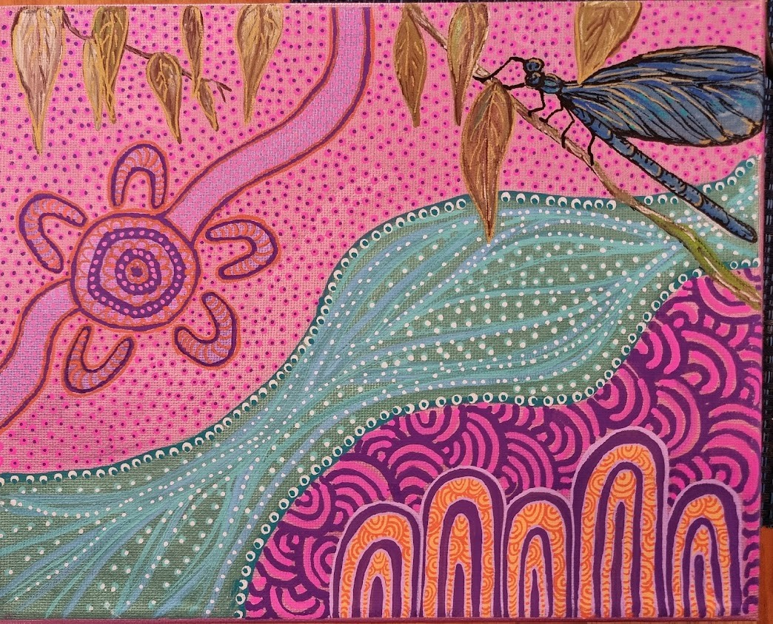
Ngarrpadlarna Mila Aboriginal Corporation
Ngarrpadlarna Mila is a Kaurna word for The 5 Aunties.
We acknowledge the cultural authority and expertise of this group and thank them for their collaboration on this work.
They are a group of Aboriginal teachers and leaders with a lifetime of experience working in Education in South Australia and in particular knowledge on Aboriginal Education across all sectors.
For more information: ngarpadlarnamila5@gmail.com
Artwork by Eva Wilson

Slide 4
Teacher Notes
Learning Intentions:
In this unit students will:
Explore the themes in the book My Feet – considering the importance of taking care of our feet, the different relationships that are important to us, dealing with disappointment and expressing emotions.
Links to Health and Physical Education Australian Curriculum:
Identities and Change
AC9HPFP01
Investigate who they are and the people in their world.
Making healthy and safe choices
AC9HPFP06
Identify health symbols, messages and strategies in their community that support their health and safety

Slide 5
Teacher Notes
Key Concepts
Cross-Curriculum Links
Key Questions
Healthy choices
Relationships
Emotions
English
Maths
The Arts
Kaurna Language
Why are our feet important?
What relationships are important to us?
What do emotions look like?
Teaching and Learning: independent lessons or successive
Lessons can be taught independently or successively as a unit of work over a period of 2-3 weeks. Any independent lessons taught will need to start with the teacher reading the story aloud to students.

Slide 6
Let’s yarn about the My Feet book!
Written by Aimee Chan
Illustrated by Leilamarie Stuart-Likouresis

Slide 7
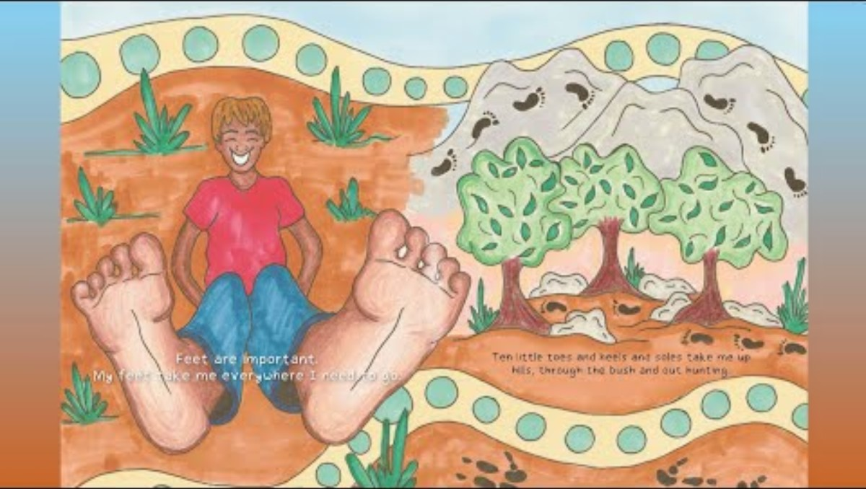
Digital reading:
Notes:
Digital reading of the book can be found here: https://youtu.be/q2CcK6tXgfw

Slide 8
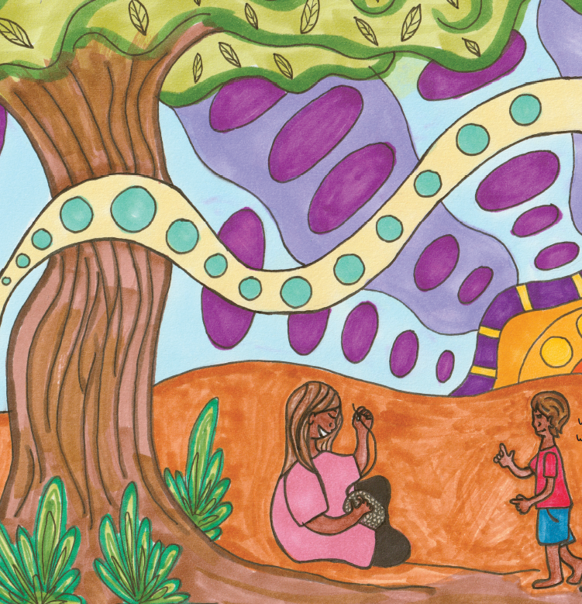
Unfamiliar words
Soles
Goals
Waterhole
Sweets
Medical clinic
Witchetty grubs
Antiseptic
Bush medicine
Notes:
The teacher reads My Feet by Aimee Chan aloud to the students. Discuss unfamiliar vocabulary

Slide 9
Let’s play Simon Says!
Notes:
Everyone stands, quick round of Simon Says or focus on actions with the feet – jump three times, hop one foot twice, stomp your feet four times, turn around twice and sit back down.

Slide 10
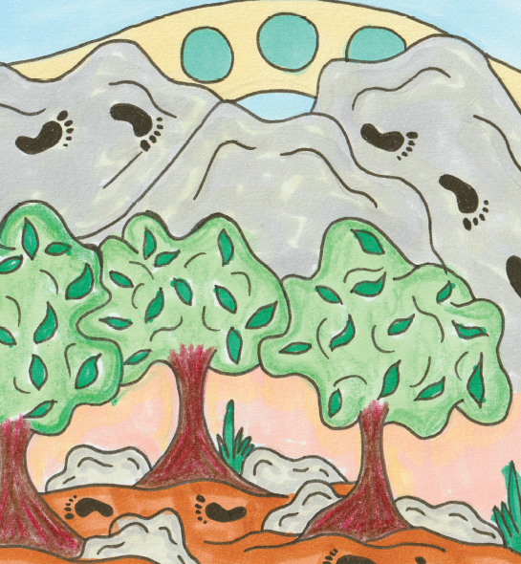
Discussion
What have your feet done today?
Why are our feet important?
What are some of the ways that we can look after them?
Notes:
What have your feet done today? Give students a minute to think for themselves, chat with the person beside them, and share with the class.
Follow up - Why did the clinic nurse in the story say the young person in the book should wear shoes? Why do we wear shoes at school? Emphasise the importance of protecting our feet and making sure they don’t get hurt.
Look at the table of ‘how to take care of our feet’ on the final page of the book. The first tip is to walk every day. Let’s take our feet for a walk and play.

Slide 11
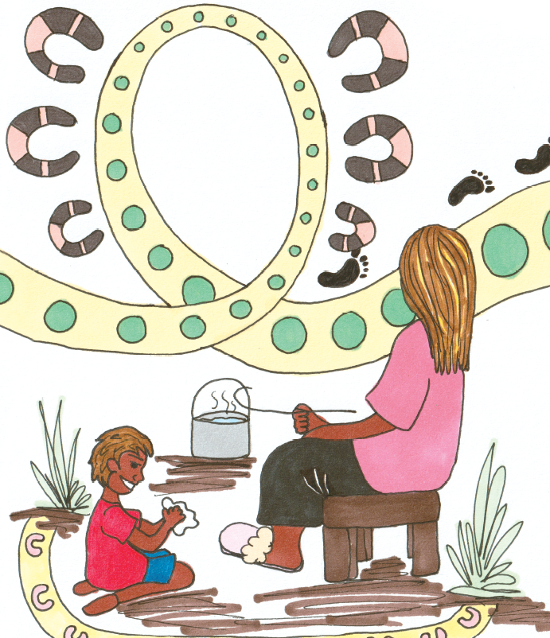
Discussion
Why do we wear shoes?
What are some other ways that we can protect our feet?
Notes:
What have your feet done today? Give students a minute to think for themselves, chat with the person beside them, and share with the class.
Follow up - Why did the clinic nurse in the story say the young person in the book should wear shoes? Why do we wear shoes at school? Emphasise the importance of protecting our feet and making sure they don’t get hurt.
Look at the table of ‘how to take care of our feet’ on the final page of the book. The first tip is to walk every day. Let’s take our feet for a walk and play.

Slide 12
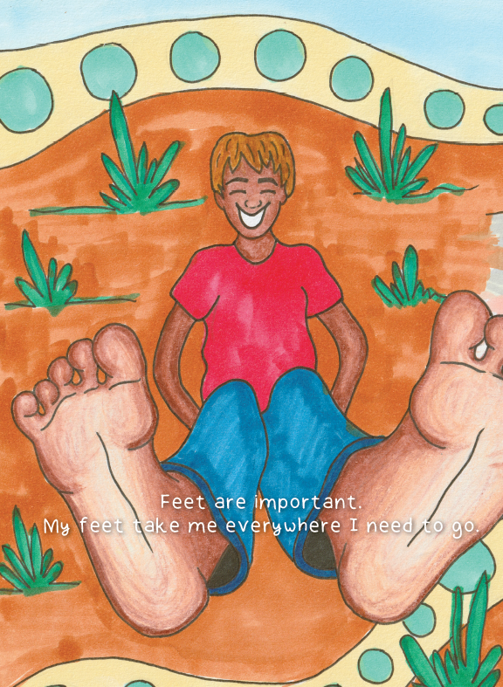
My feet take me places
Where do your feet take you?
Let’s write some sentences…
Notes:
Let’s read the book again focusing on the first 6 pages.
Where do your feet take you?
Some suggestions if the students are struggling to come up with ideas – school, park, shops, visiting family and friends, canteen, library, school oval, home, movies.
Writing and drawing task – the students complete the sentence “My feet take me to _________’ and draw a picture to go with their sentence. Some students may need the teacher’s help scribing the words to complete their sentence. If there is time at the end of the lesson, spend some time sharing student work.

Slide 13
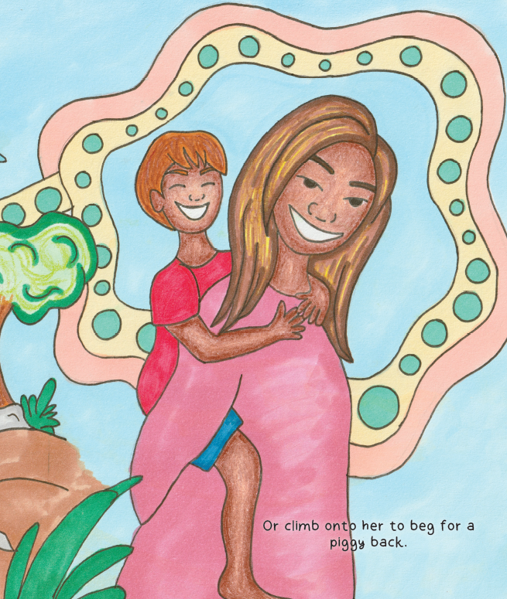
‘My’ sentences
Let’s read the My Feet book
Raise your hand every time you hear the word ‘my’
Let’s chat about it
Notes:
Investigate the book My Feet and recognise that it contains the heart word ‘my’ (4th heart word in the Department for Education’s phonics program being taught in SA public schools).
The teacher reads the book aloud, getting students to silently raise their hands every time they hear the word ‘my’. While sitting on the mat, discuss the two letters in the word ‘my’. Depending on how far through the Foundation year they are, they may be able to tell you other words that start with ‘m’ and other words that start with ‘y’. Practise sky writing ‘my’ and if mini whiteboards are available, practice writing with a marker and displaying efforts to teacher under their chin. Using the printed sheet provided, students practise writing the word ‘my’ for each square on the page, then draw their feet, hands, face and friends.

Slide 14
How can we look after our feet?
Dry them carefully
Socks
Shoes
Keep an eye on them and check them for sores or cuts
Keeping them clean
Notes:
Optional: The teacher read aloud the complete story My Feet again.
In lesson 1 unfamiliar vocabulary was discussed – this lesson encourages students to silently raise their hand if they hear a word they do not know the meaning of. There will be some who have forgotten the previous explanations, so this will help to reinforce new word knowledge.
What are some of the things we should do to look after our feet? (check them for injuries, wash them, wear shoes, dry between toes, walk every day etc.)

Slide 15
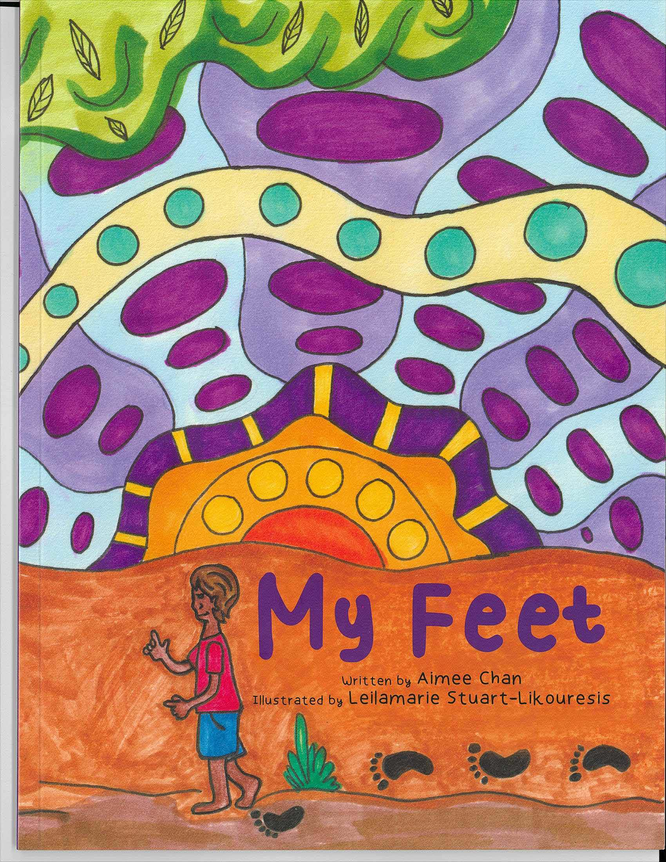
Let’s make a book
Come up with a picture for the front cover
Inside your book;
3 ways to look after your feet
You could use ideas from the My Feet book or come up with your own
Let’s share our work!
Notes:
Students will create their own book about looking after their feet.
Instructions:
Come up with a picture to draw on the front cover of your book – remember, this is a book about looking after our feet so what are some of the things you could put on your cover?
Inside your book you need to draw at least 3 ways you can look after your feet. You can use the ideas from My Feet, or you might be able to think of some new ideas of your own.
Have a go at writing some words for each page - but the teacher may need to scribe for some students.
If there is time at the end of the lesson, share some of the students' ideas.

Slide 16
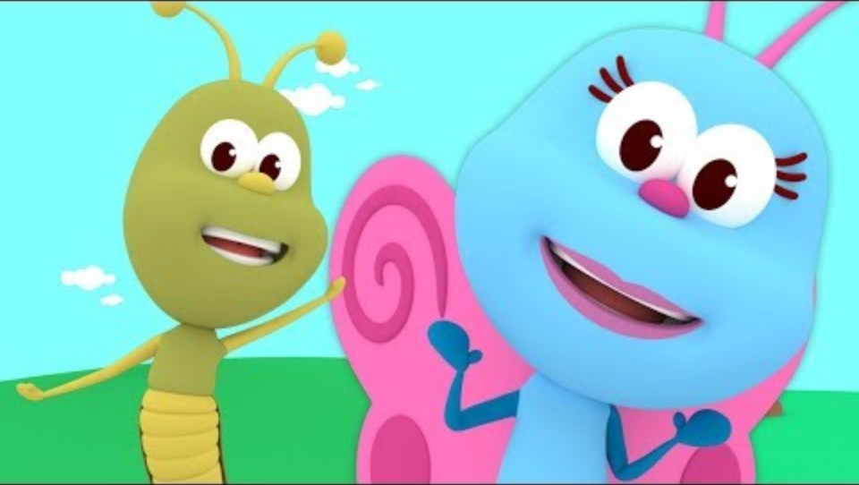
Let’s sing about our feet!
Singing and dancing are important ways to learn
First Nations people have shared knowledge through song, dance and storytelling for years
Notes:
Singing and dancing are important ways to learn
First Nations people have shared knowledge through song, dance and storytelling for many thousands of years, sharing vast amounts of knowledge in these ways
Warm up activity – listen and watch the Youtube video Feet, feet, feet (https://youtu.be/TXMGR0XznF8). Play the video a second time and get children up to dance and sing along. The song is in call-and-respond style, so students should be able to join in.
Kaurna language note: if you want to introduce some Kaurna language, the most common word for kangaroo in Kaurna is tarnta. This could be introduced to students after the information video, which features kangaroo feet.

Slide 17
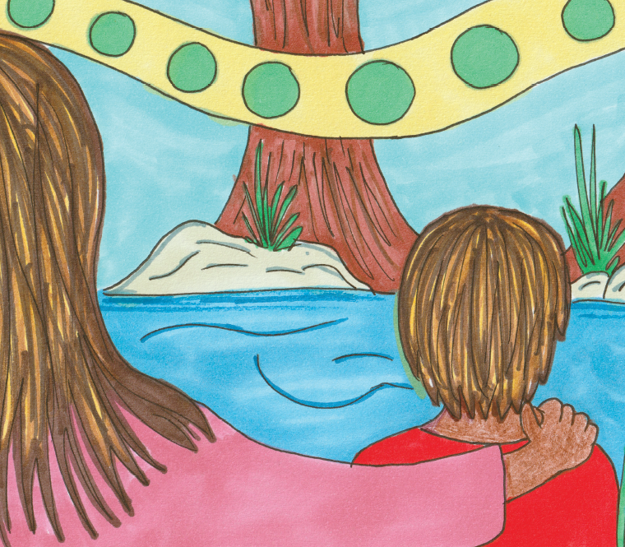
Let’s chat about books
What is someone who writes books called?
Author
What is someone who draws the pictures called?
Illustrator
Notes:
Next, explain to students that there are two types of books – one that has made up stories, and one that gives us facts. Introduce the words fiction and non-fiction. The book My Feet is a little bit of both – the story about the young character and Aunty’s sore feet, but also lots of information about how to take care of our feet.

Slide 18
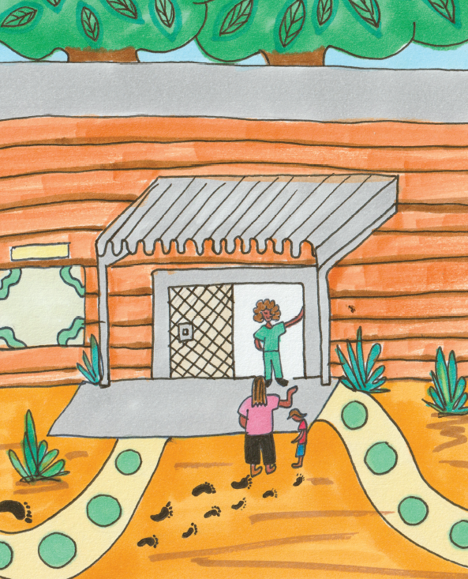
Let’s chat about books
There are different types of books
Fiction and Non-Fiction books
My Feet is a bit of both
Notes:
Next, explain to students that there are two types of books – one that has made up stories, and one that gives us facts. Introduce the words fiction and non-fiction. The book My Feet is a little bit of both – the story about the young character and Aunty’s sore feet, but also lots of information about how to take care of our feet.

Slide 19
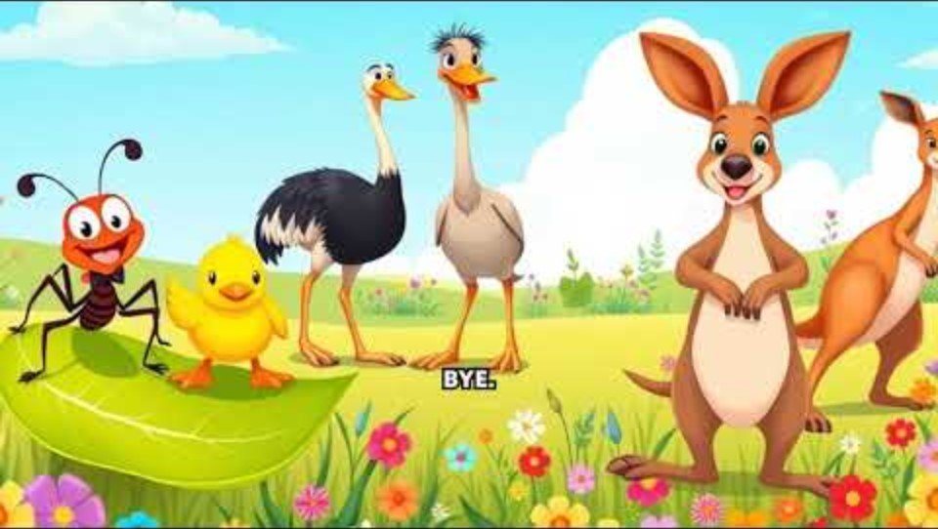
Feet come in different sizes
Can you think of another animal with tiny feet?
What about one with big feet?
Notes:
The next video we are going to move along to also has lots of facts about feet – different kinds of feet, different sized feet. Play the video through first in full for students to watch and listen, then play a second time and get them up and moving along.
Discussion – can they think of another animal with tiny feet? Or another animal with very big feet?
If time, finish with another dance along to Feet, feet, feet.
Link to video: https://youtu.be/orRIcVs8gaY
Kaurna language note: if you want to introduce some Kaurna language, the most common word for kangaroo in Kaurna is tarnta. This could be introduced to students after the information video, which features kangaroo feet.

Slide 20
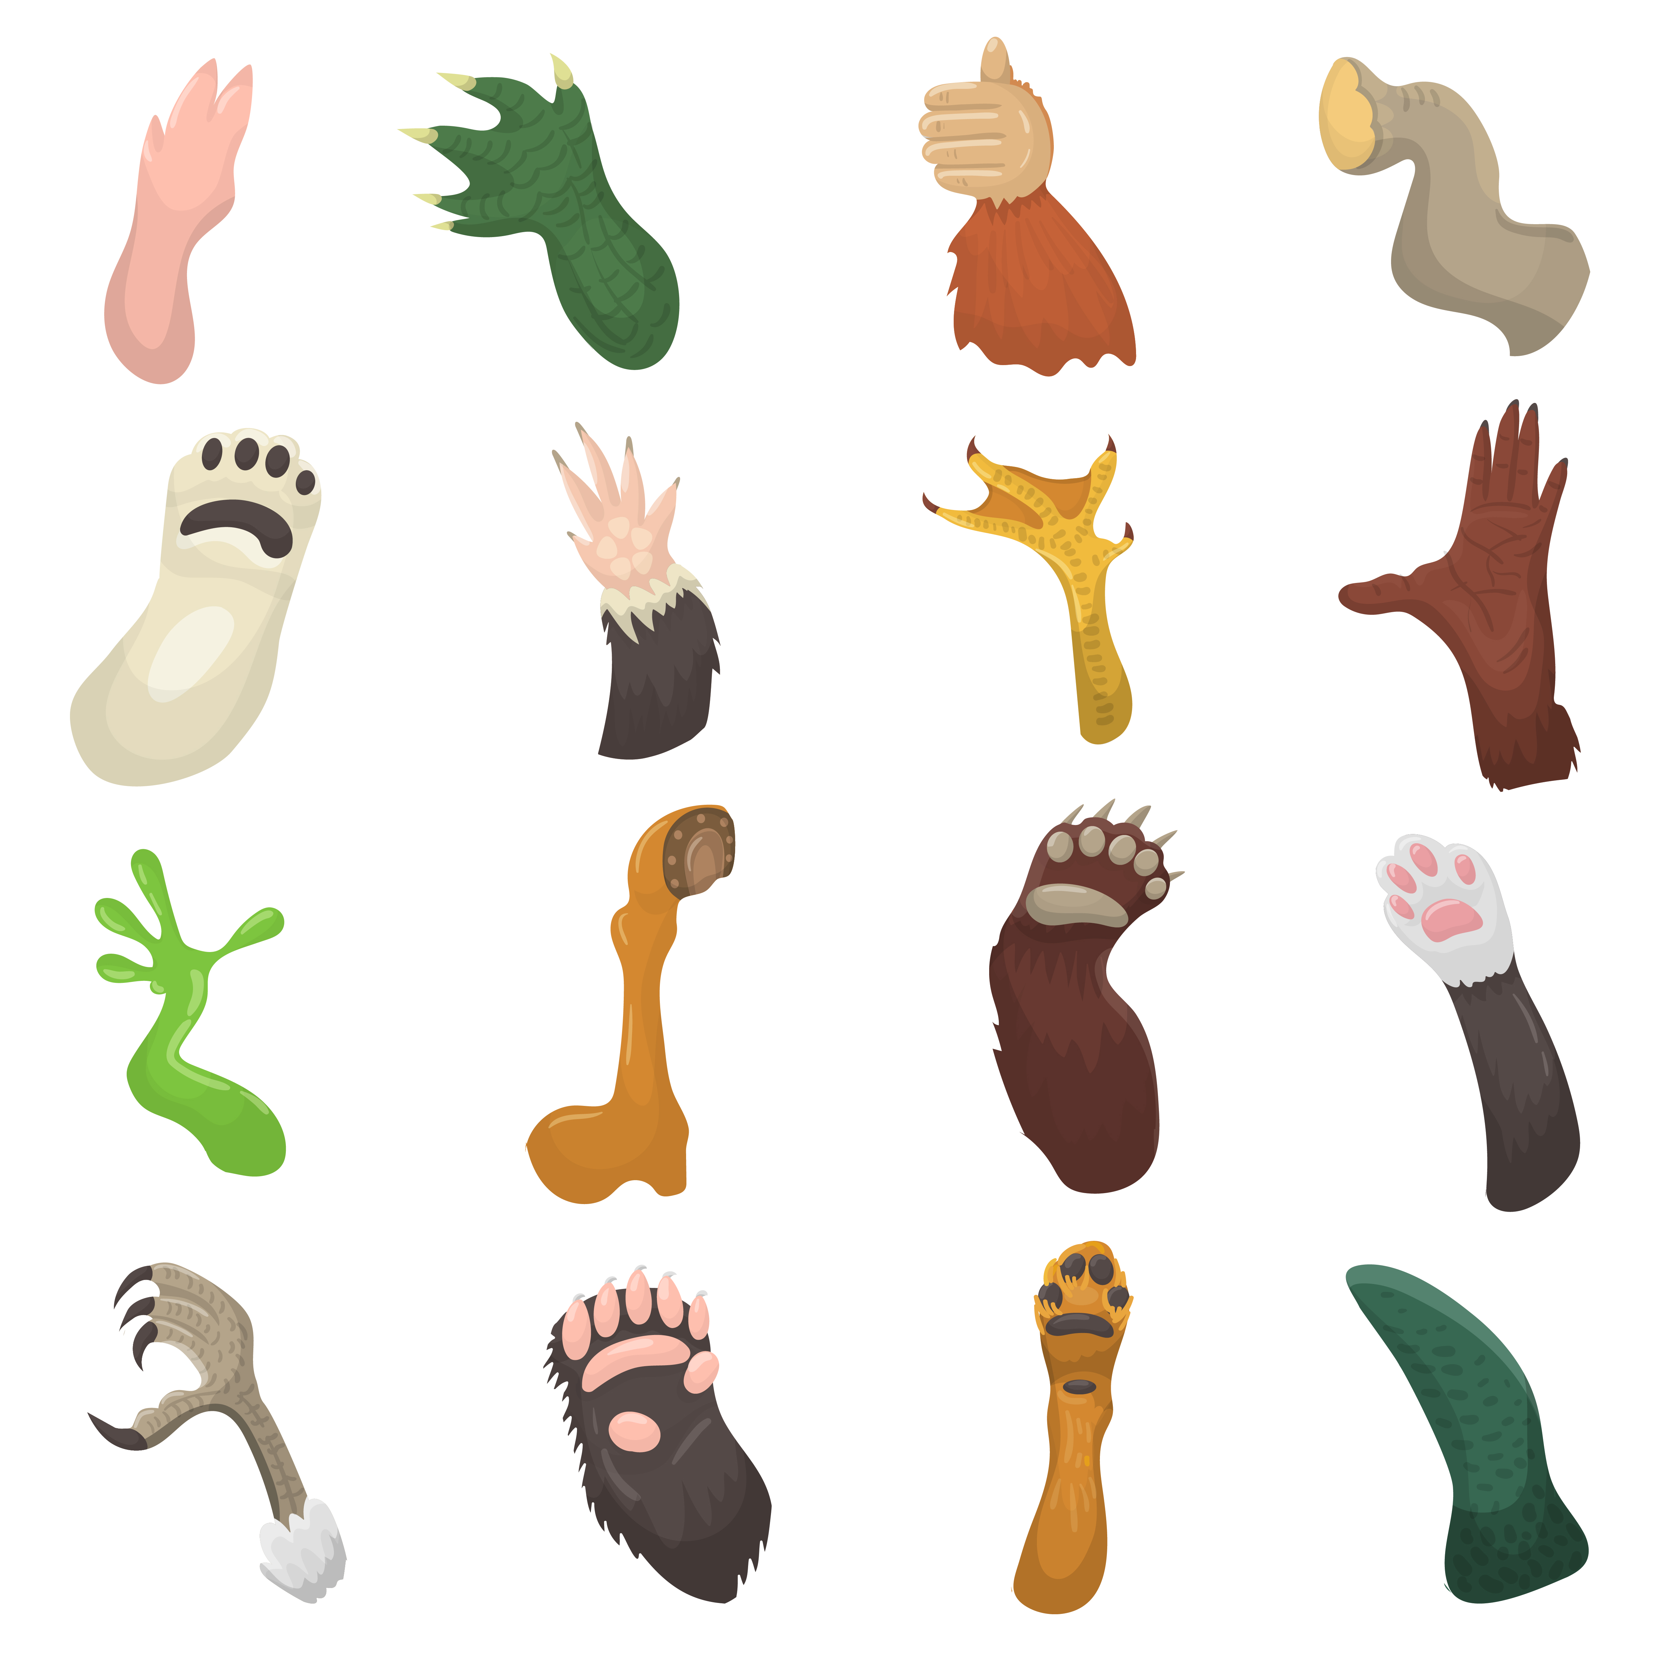
Let’s make some feet
There are lots of different feet in the world
Can you think of some feet that look different to ours?
How are they different?
What do they have in common?
Notes:
Optional whether to start with another reading of the book My Feet)
Highlight the image to the students.
Classroom discussion – there are lots of different looking feet in the world. How are they different? What do they have in common?

Slide 21
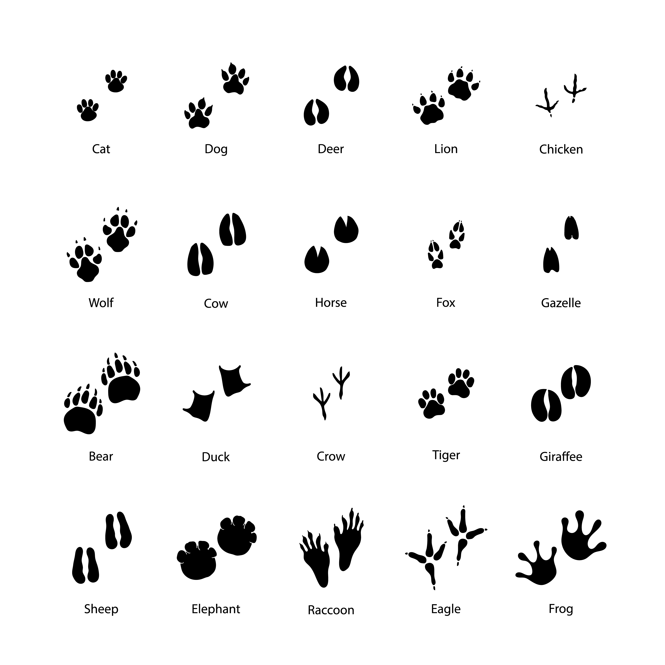
Let’s make some feet
What might their footprints look like?
Notes:
Discussion around what the footprints might look like.

Slide 22
Let’s make some feet
Let’s make some models of feet! It can be a human foot or an animal foot - anything that you want it to be!
Notes:
This lesson the students are making feet from air dry clay or plasticine, depending on materials available. Students can choose to make a human foot or an animal foot – see PowerPoint for ideas. Once they have the shape of the foot made, they can use a sharp pencil to carve some decorations into the clay surface.
Conclude the lesson with a presentation by any students who want to share – what kind of foot did they make and what kind of decorations did they use?
If you have a parent sharing platform like Seesaw available, pictures of the final creations can be uploaded.

Slide 23
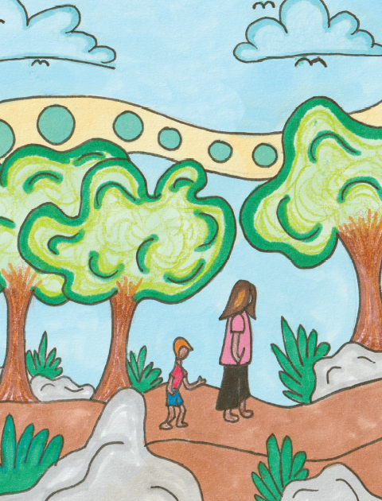
Protecting our feet
What can we do to protect our feet?
What kind of shoes do you wear?
Notes:
Begin this lesson with a discussion about the importance of protecting our feet by wearing appropriate shoes.
Class discussion question - What kinds of shoes do you wear?
There are lots of different kinds of shoes and people in different parts of the world wear different styles of shoes. Encourage students to notice the different features of different types of shoes. This will give them ideas for the task below.

Slide 24
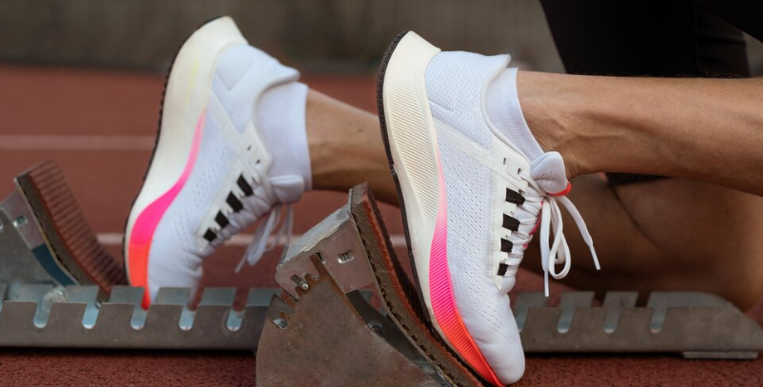
Different types of shoes
Talk to the person next to you about what some different types of shoes
Supportive around the ankle and whole foot
Fits well, not too big or small
Supportive sole (underneath) to absorb shock
Example of a supportive shoe!
Notes:
Encourage discussion around what makes a ‘good’ shoe and how it protects our feet and ankles.

Slide 25
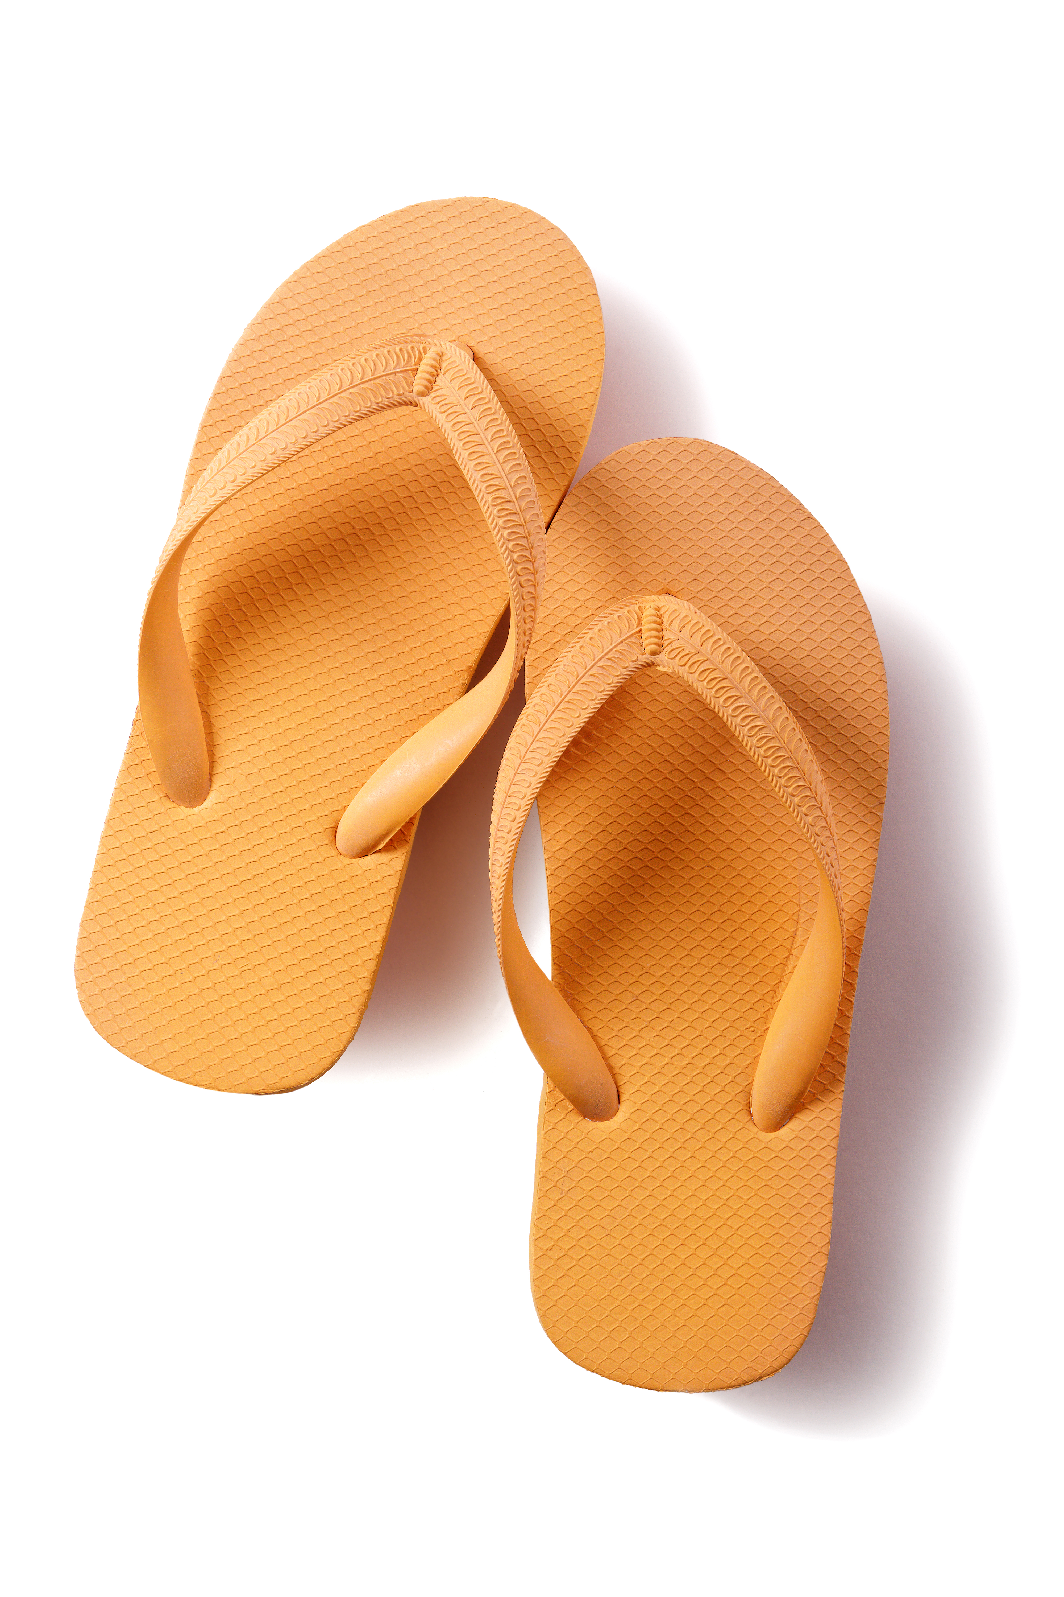
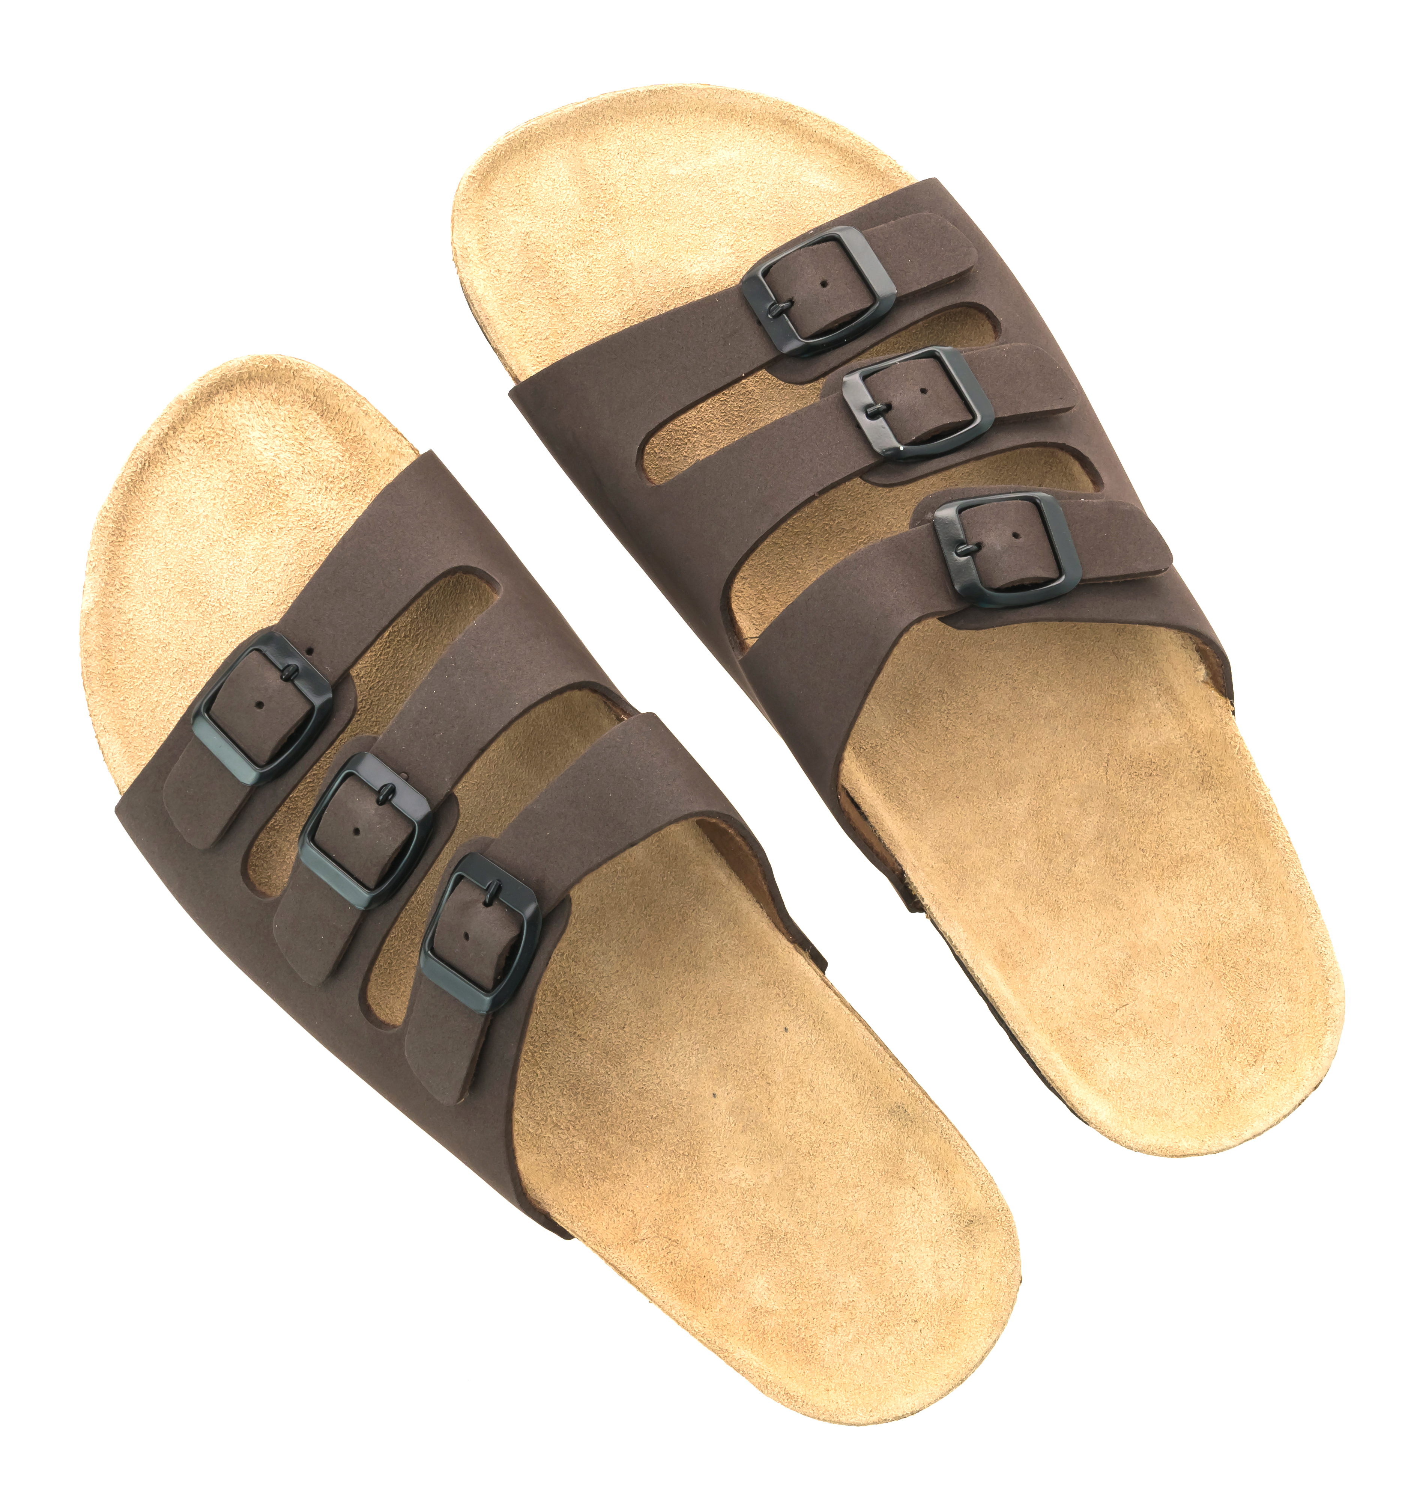

‘Sometimes’ shoes
Not supportive around the ankle, toes or underneath
Might change the natural shape of the foot
Your foot needs to ‘hold on’ to keep them on
Notes:
These are shoes that the foot needs to grip onto to keep them on, or the foot might easily slide out.

Slide 26
Let’s make some shoes!
Grab some art supplies and let’s make a shoe that can stay on your foot long enough to take a photo!
Notes:
Make a pair of shoes that will stay on your feet long enough to take a photo. If possible, share photos of creations with families. If there is any time at the end of the lesson, get students to ‘show and tell’ about their creations with the class.

Slide 27
Important people in my family!
Who is the important adult for the young child in the book?
What is an Aunty?
Families can be very different
Some are big
Some are small
Notes:
Important: Before discussing the nature of families with students, check backgrounds in case there are any family situations that require sensitivity.
Teacher background: In many cultures Aunty is your mum or dad’s sister. In Aboriginal culture, female Elders are addressed as Aunty and often any older women in your family or community will be called Aunty.
Begin a discussion utilising the prompts on the slide.

Slide 28
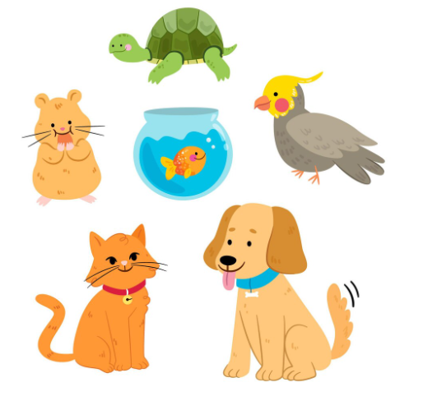
Important people in my family!
Who has the largest family?
Who has the smallest?
Does anyone have pets?
Who is the most important person to you?
Maybe there are multiple!
Add image
Notes:
Important: Before discussing the nature of families with students, check backgrounds in case there are any family situations that require sensitivity.
Teacher background: In many cultures Aunty is your mum or dad’s sister. In Aboriginal culture, female Elders are addressed as Aunty and often any older women in your family or community will be called Aunty.
Discuss how families can be very different – some very big with lots of aunties and uncles and cousins, some very small, some with a mum and dad, but some with maybe two mums or two dads or maybe nan or pop might live with you. You might have older brothers or sisters, or younger ones, or none. Who in the class has the largest family? Who has the smallest family? Who has pets in their family?

Slide 29
Let’s do some art!
Draw or paint a picture of the important people in your life.
Write who they are, the teacher can help you if you need.
Notes:
Drawing and writing task – who are the important people in your family? Draw or paint a picture of your family. Those able to write can label the people in their family. The teacher will need to circulate to scribe for those unable to write.
Share work at the end of the lesson if there is time.

Slide 30
Identifying emotions
Scared
Happy
Squirmy
How are you feeling today?
Angry
Excited
Sad
Tired
Surprised
Frustrated
Notes:
This lesson focuses on feelings and recognising different emotions. Begin with a discussion about how the students are feeling today to get them thinking about different possible feelings – happy, sad, tired, confused, surprised, angry, scared, frustrated. Keep in mind, young children may use different words for their emotions, eg: squirmy (uncomfortable), bouncy (excited).
Consider utilising the 6 Basic Types of Emotions: Happiness, Sadness, Fear, Disgust, Anger, Surprise.

Slide 31
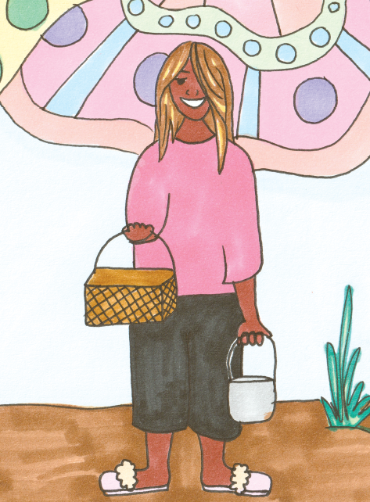
Discussion points from the story
How did the character in the story feel when Aunty started to get better and wasn’t sitting under the tree anymore?
Why were they sad?
What are some things that we can do when we are sad?
Notes:
Discussion questions - How did the character in the story My Feet feel when Aunty started to get better and wasn’t sitting under the tree anymore? (sad, crying)
Why were they sad?
Sometimes we need to cry – but what are some other things we might do when we are sad? (be very quiet, cuddle with a toy, sit with our pets, find someone to talk to etc.)
Practise recognising different emotions, discussing what we can do when we feel these emotions. You could do this with facial expressions from the teacher or ask for volunteer students to show different emotions on their faces.
Emoji writing and drawing tasks – on a sheet of paper draw three different ‘emoji’ faces. One of them is sad – you choose the other two emotions. If you are able to write the words, record the emotion, otherwise the teacher will need to scribe for children. Early finishers record some extra emotion emojis.

Slide 32
Let’s do some drawing!
On a piece of paper, draw some faces showing different emotions.
Write underneath what emotion is being shown.
If you have extra time, you could draw some more.
Notes:
Emoji writing and drawing tasks – on a sheet of paper draw three different ‘emoji’ faces. One of them is sad – you choose the other two emotions. If you are able to write the words, record the emotion, otherwise the teacher will need to scribe for children. Early finishers record some extra emotion emojis.

Slide 33
Counting with our toes!
How many feet do we have?
How many toes do we have?
Let’s practice our counting, by counting the toes on the paper cutouts!
Notes:
In the book My Feet, the author talks of ‘ten little toes’ - focus on this feature of the book for a maths activity.
Provide each student with a sheet of paper with two feet outlined or allow students to remove shoes and trace around their own feet. (Ensure it features separate toes – see note and link in side column.)
Practise fine motor skills – cut out the feet. Work together as a class to write the numbers 1-5 on one foot, with the teacher modeling on the whiteboard. On the second foot repeat with the numbers 6-10. Some students may require a scribe.
To begin, each student holds just the foot containing the numbers 1-5. Form groups of two – together, work out how many toes you have. Hands up when you know. Double-check the answer by counting together out loud.
Next, form groups of 3 and repeat the task. Depending on skill level, form groups of 4. If they can do groups of 4, then try with the students holding both the cut-out feet and forming groups of two. Can they now work out that they have 20 toes? Work to the appropriate skill level of the class.
To finish, stick the feet on a piece of paper, decorate/colour depending on time and write ‘I have 10 toes’. Some students may require a scribe.
Teacher note: Taking shoes off in class can get messy and chaotic – mixed up socks and smelly feet. Paper cutouts may be easier. Find outlines at https://justfamilyfun.com/free-foot-outline-template/
Teacher note: While rare, students may have foot differences such as webbed toes that may require sensitivity.

Slide 34
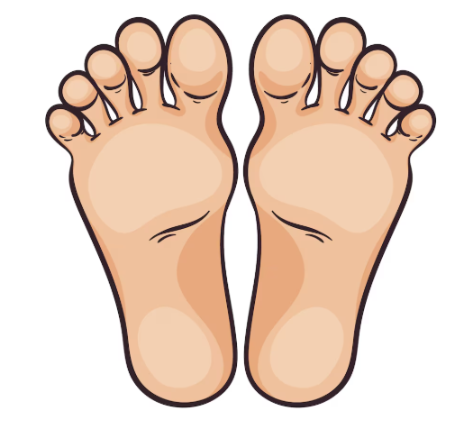
Your tidna has 5 toes
Kaurna word for foot = Tidna
Notes:
This lesson incorporates Kaurna language, learning the Kaurna word for foot and other body parts.
The Kaurna songs can be accessed via: Songs and stories in Aboriginal languages
Depending on attention levels, you can either work on the song in its entirety or focus on just the Kaurna word for foot ‘tidna’.
The song also allows for movement to assist with engagement, with students standing up and touching each body part as the words are sung.

Slide 35
Let’s sing together!
Heads
Shoulders, knees and toes, knees and toes
Heads
Shoulders, knees and toes, knees and toes
Eyes and ears and mouth and nose,
Heads
Shoulders, knees and toes, knees and toes
Notes:
If the students don’t know the song, various videos can be found on Youtube.

Slide 36
Now let’s learn it in Kaurna
Access the videos here
Notes:
The song can be found here: Songs and stories in Aboriginal languages

Slide 37
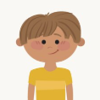
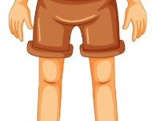
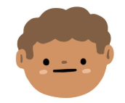
Now let’s learn it in Kaurna
Mukarta
Kartaka
Mampa
Tidna
Head
Shoulders
Knees
Toes
Notes:
The song can be found here: Songs and stories in Aboriginal languages

Slide 38
Now let’s learn it in Kaurna
Let’s listen to the first part of this video
Now let’s listen again, pausing it so that we can repeat the words
Sitting in a circle, let’s repeat the words after each other
Sing as much of the song as you can with these four words
Access the videos here

Slide 39
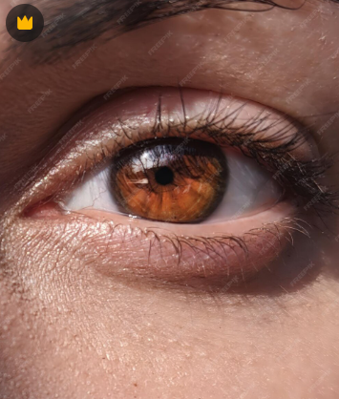
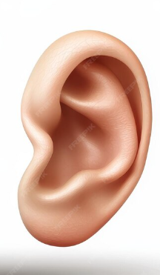
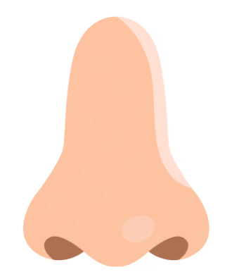

Four new words to learn
Miina
Yuri
Taa
Mudlha
Eyes
Ears
Mouth
Nose

Slide 40
Putting it together in a song
Mukarta
Kartaka, mampa, tidna, mampa, tidna
Mukarta
Kartaka, mampa, tidna, mampa, tidna
Miina, yuri, taa, mudlha, taa, mudlha
Mukarta
Kartaka, mampa, tidna, mampa, tidna
If time – drop a word each verse
Notes:
Extension – if they can remember any of the other Kaurna words, record those also, along with a picture. If possible, share the learning on a parent platform like Seesaw.
If students learn the song to an appropriate skill level, they could share the song with another class.

Slide 41
As a class we are going to create a mural of feet
We are going to design a footprint, cut it out and put it up around the room!
Notes:
Note: if you are looking for a messy, craft activity: Give each student one printed outline of a foot to colour and decorate. Cut out when complete.
While they are working on this, get them one at a time to remove one shoe and sock, put the sole of their foot into paint and put one footprint onto the large sheet of paper. Each child prints one foot in paint to create a series of feet walking across the page. When the painted feet are dry, stick the cut-outs all around the painted footprints and this will create a beautiful ‘My Feet’ mural to hang in the classroom.
When the painting task is completed, get the students to look at the footprints and discuss – how are all the footprints different?
If not wanting a mess, utilise the foot print cut outs, making sure to incorporate some left and some right feet, so the foot prints can walk across the room (cutting them out first and flipping them over)

Slide 42
Teacher Information
Sometimes foot care requires support from a professional. If you notice a student who has pain in their feet or cuts/sores that aren’t healing within 2-4 weeks, it is important that you recommend that they visit their GP or a Podiatrist. This is extra important if the student has diabetes.
Things to look out for:
Cuts/sores that aren’t healing within 2-4 weeks
Redness, hot, swollen are all signs of infections in cuts/sores
If it is an Aboriginal or Torres Strait Islander student, they can access a bulk billed podiatrist through the local Aboriginal Health Service. For non-Indigenous students, they can access a podiatrist without a referral but this will incur a cost. You can find your local podiatrist at APodA.
Notes:
Find A Podiatrist - Australian Podiatry Association Ltd

Slide 43
Teacher Information
For more information on diabetes, visit: Diabetes Feet Australia
https://www.diabetesfeetaustralia.org/for-patients/
For more resources on foot health and our other curriculum resources, please visit:
https://sahmri.org.au/research/themes/aboriginal-health/programs/health-systems-research/projects/walk-strong-walk-tall/highlights
This resource has CC BY-NC-ND Licensing. This license enables reusers to copy and distribute the material in any medium or format in unadapted form only, for noncommercial purposes only, and only so long as attribution is given to the creator.

Slide 44
Thank you and one last thing…
We genuinely thank you for utilising this resource. Programs like ours rely on grant funding and community feedback around the utilisation of our resources greatly supports our grant applications.
If you have a moment, it would be greatly appreciated if you could complete this short survey:
https://redcap.sahmri.com/surveys/?s=TRXEEFRD4YMX9L87
It is only a few questions that will allow us to know that you utilised this resource in your classroom.
If you have any questions or want to discuss anything, please reach out to: Wardliparingga@sahmri.com
Thank you.

